Slide 1

B.Sc. THESIS DEFENSE
An Ultra-Low-Power 10-Transistor
1-Bit Magnitude Comparator
PRESENTER
Shahrear Hossain
Using Gate Diffusion Input (GDI) Technique
Matric No: ET223104
Dept. of Electrical & Electronic Engineering
International Islamic University Chittagong
Transistor-Level VLSI Circuit Optimization Across 180nm, 90nm & 45nm PTM Nodes
SUPERVISOR
Riazul Islam
Lecturer, Dept. of EEE, IIUC
October 2026

Slide 2
DEPARTMENT OF EEE, IIUC | B.Sc. THESIS DEFENSE
Presentation Roadmap & Agenda
01
Introduction
04
Methodology
VLSI scaling, low-power constraints & motivation.
LTSpice simulation setup across 180nm, 90nm & 45nm PTM.
02
Problem Statement
05
Results & Discussion
Limitations of 26T CMOS & 16T Transmission Gate designs.
Transient output waveforms, power, delay & PDP analysis.
03
Proposed Solution
06
Conclusion
10-Transistor GDI magnitude comparator architecture.
Summary of contributions & future multi-bit ALU scope.
Shahrear Hossain (ID: ET223104) | 10T GDI 1-Bit Magnitude Comparator

Slide 3
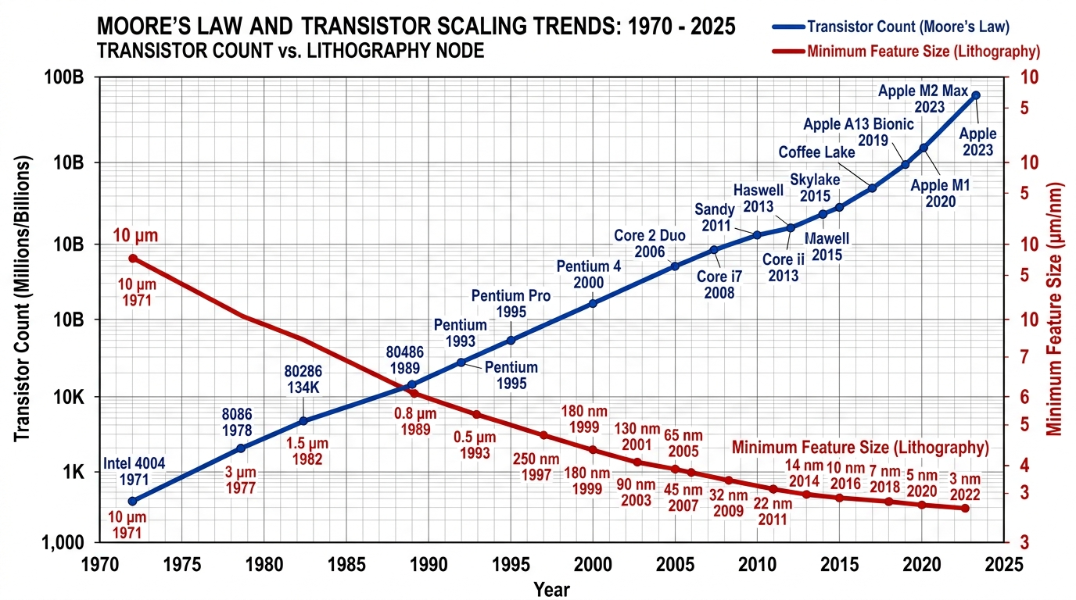
DEPARTMENT OF EEE, IIUC | B.Sc. THESIS DEFENSE
1. Introduction & Research Background
VLSI Technology Scaling Challenges
Power Density & Integration Trend
• Exponential Device Scaling:
Deep sub-micron nodes face high static leakage & dynamic power.
• Battery & Thermal Constraints:
Portable IoT & biomedical CPUs require sub-microwatt operation.
• Essential Arithmetic Block:
Magnitude comparators govern speed in ALUs, DSPs & ADCs.
Shahrear Hossain (ID: ET223104) | 10T GDI 1-Bit Magnitude Comparator

Slide 4
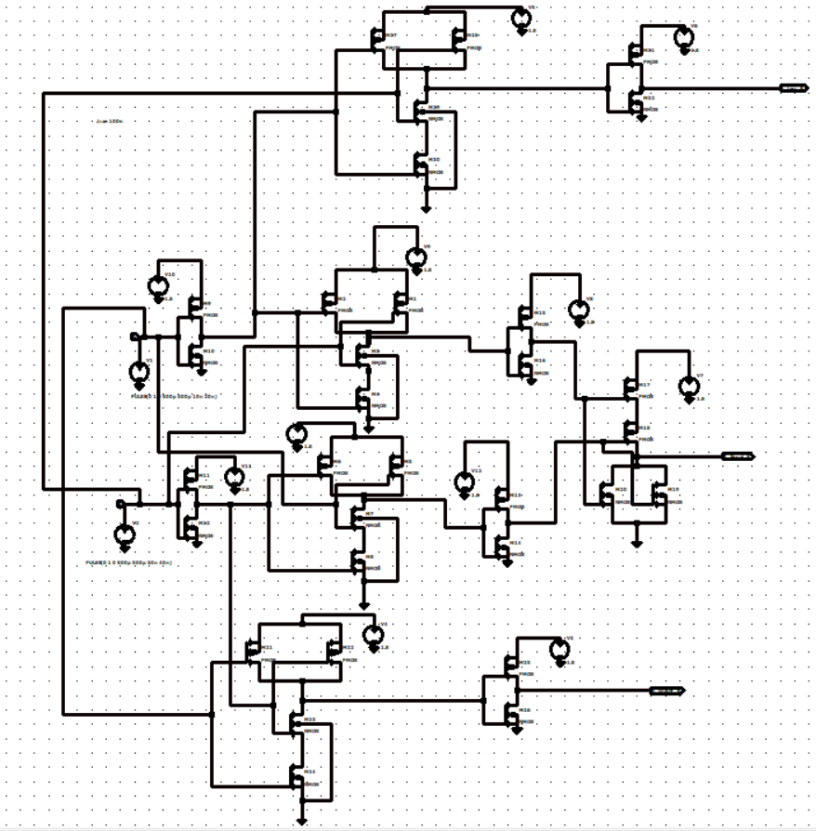
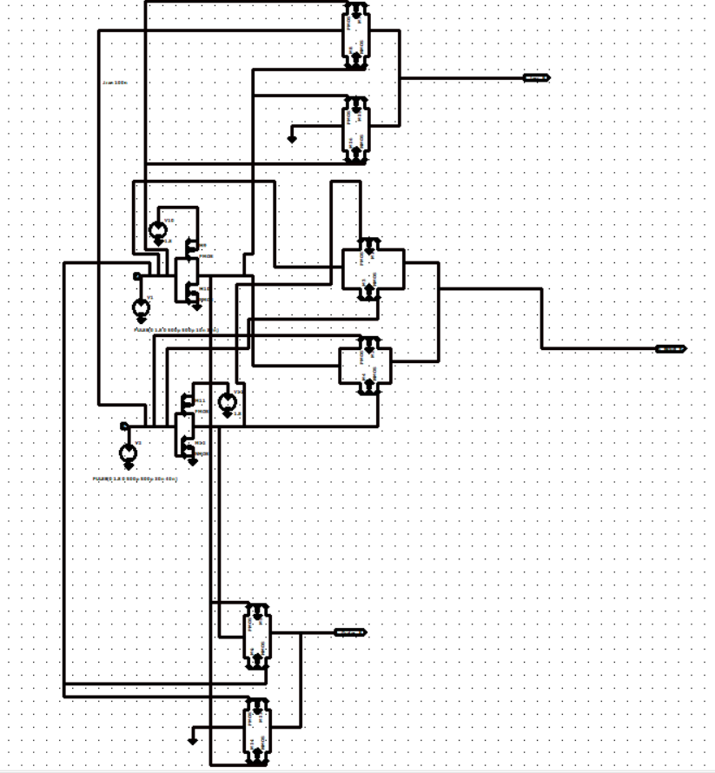
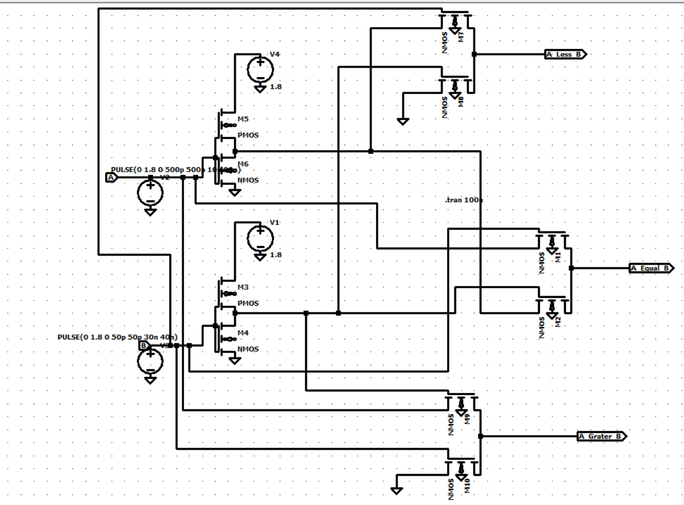
DEPARTMENT OF EEE, IIUC | B.Sc. THESIS DEFENSE
2. Problem Statement: Conventional Comparator Limitations
Static CMOS (26T)
Transmission Gate (16T)
Pass Transistor (12T)
• Heavy 26-transistor count.
• Large silicon layout footprint.
• High internal parasitic capacitance.
• Requires 16 transistors.
• Dual inverted control lines (A, A').
• High interconnect routing overhead.
• 12 to 14 transistor budget.
• Severe Vth threshold voltage drop.
• Signal degradation at low VDD.
Shahrear Hossain (ID: ET223104) | 10T GDI 1-Bit Magnitude Comparator

Slide 5
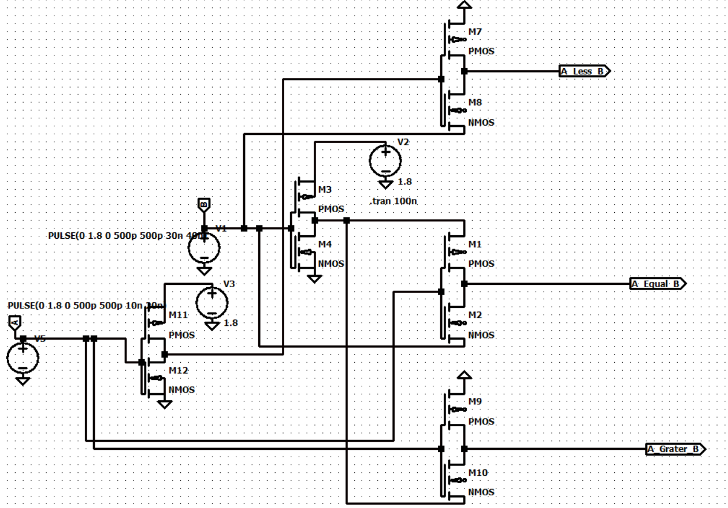
DEPARTMENT OF EEE, IIUC | B.Sc. THESIS DEFENSE
3. Proposed Solution: 10T GDI Magnitude Comparator
Proposed Circuit Innovations
10T GDI Circuit Schematic Diagram
• 61.5% Transistor Reduction:
Cut total count from 26T down to only 10 Transistors.
• Gate Diffusion Input (GDI):
Uses 2-transistor primitive cells to execute complex logic.
• Zero Hardware Redundancy:
Directly computes A<B, A>B, and A=B without extra buffers.
Shahrear Hossain (ID: ET223104) | 10T GDI 1-Bit Magnitude Comparator

Slide 6
DEPARTMENT OF EEE, IIUC | B.Sc. THESIS DEFENSE
4. Methodology & Simulation Framework
LTSpice XVII Simulation Setup
Implementation Scope & Verification
• Technology Models:
Predictive Technology Model (PTM) 180nm, 90nm & 45nm.
• Supply Voltage Scaling:
1.8V (180nm), 1.2V (90nm), and 0.8V - 1.0V (45nm).
• Input Test Vectors:
Transient pulses at 100 MHz to 1 GHz frequencies.
SOFTWARE SIMULATION STUDY
• Validation is strictly simulation-based (SPICE level).
• No physical IC fabrication / hardware tape-out.
• Measured Metrics:
1. Average Power Dissipation (Pavg)
2. Propagation Delay (tpd at 50% transition)
3. Power-Delay Product (PDP = Pavg × tpd)
Shahrear Hossain (ID: ET223104) | 10T GDI 1-Bit Magnitude Comparator

Slide 7
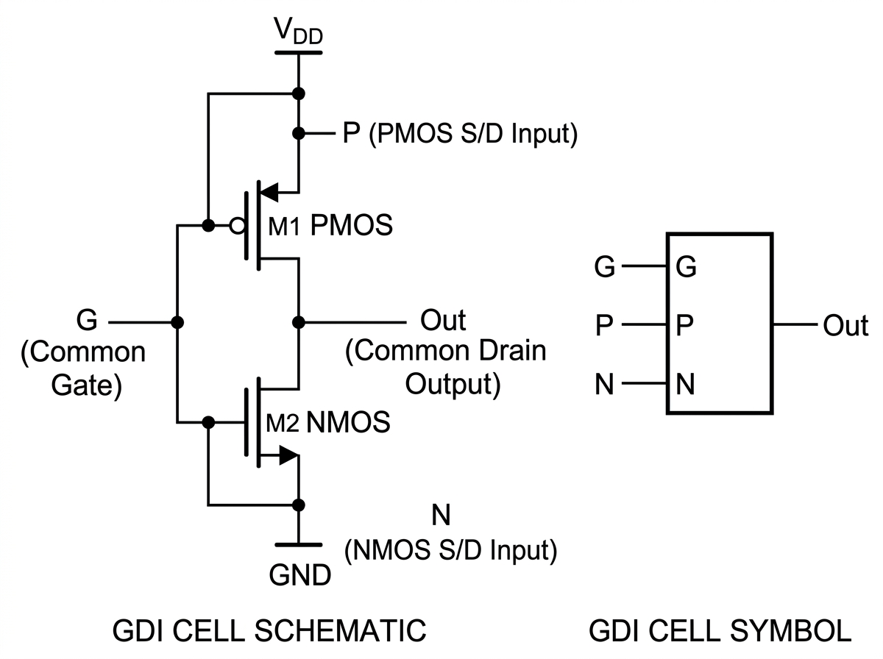
DEPARTMENT OF EEE, IIUC | B.Sc. THESIS DEFENSE
4. Gate Diffusion Input (GDI) Cell Mechanics
2-Transistor GDI Cell
Comparator Output Equations
1. A < B Output (GDI Cell 1 - 2T):
Equation: A < B = A' · B
2. A > B Output (GDI Cell 2 - 2T):
Equation: A > B = A · B'
3. A = B Output (NOR / XNOR Stage - 6T):
Equation: A = B = ((A < B) + (A > B))' = A ⊙ B
Total Budget: 2T + 2T + 6T = 10 Transistors
GDI Cell inputs (P, N, G) accept arbitrary logic variables, enabling complex functions in just 2 transistors.
Shahrear Hossain (ID: ET223104) | 10T GDI 1-Bit Magnitude Comparator

Slide 8
DEPARTMENT OF EEE, IIUC | B.Sc. THESIS DEFENSE
5. Results: Quantitative Performance Comparison (45nm)
Performance Comparison Table at 45nm PTM Node (VDD = 1.0V)
Architecture Style | Transistor Count | Delay (tpd) [ps] | Power (Pavg) [µW] | PDP [aJ]
Static CMOS | 26T | 48.2 ps | 14.82 µW | 714.3 aJ
Transmission Gate (TG) | 16T | 31.5 ps | 8.94 µW | 281.6 aJ
Pass Transistor (PTL) | 12T | 27.8 ps | 6.45 µW | 179.3 aJ
Proposed GDI Design | 10T (-61.5%) | 18.4 ps (-61.8%) | 2.15 µW (-85.4%) | 39.56 aJ (18× Better)
Key Takeaway: The proposed 10T GDI comparator achieves 85.4% lower power and 18× lower PDP compared to standard 26T CMOS.
Shahrear Hossain (ID: ET223104) | 10T GDI 1-Bit Magnitude Comparator

Slide 9
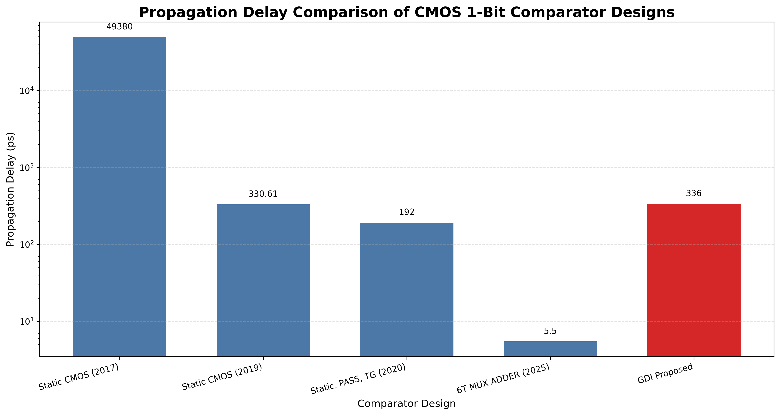
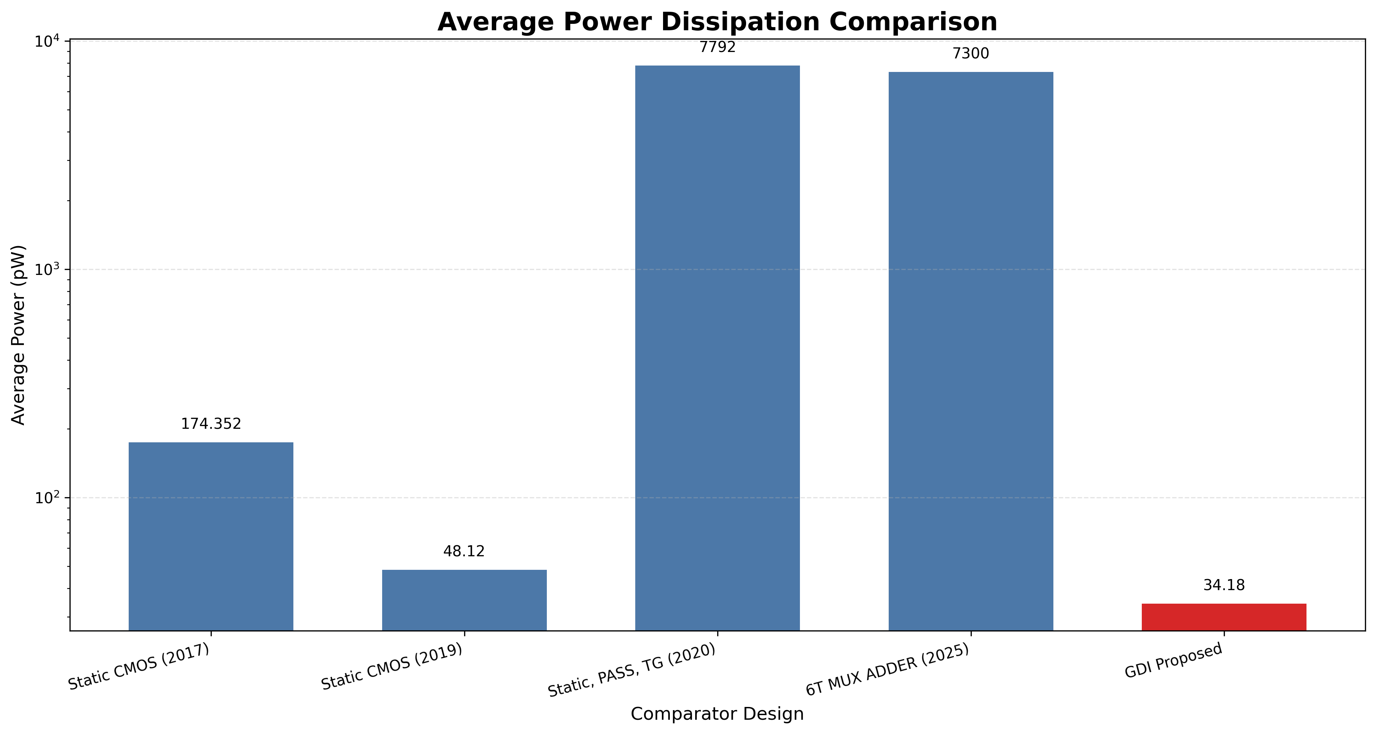
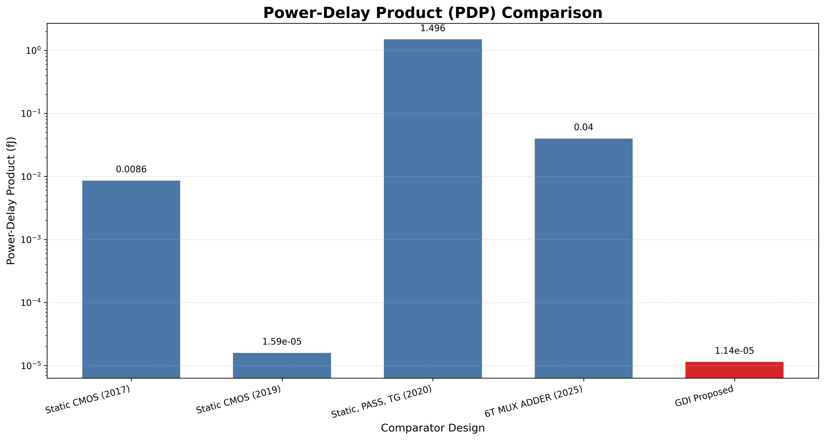
DEPARTMENT OF EEE, IIUC | B.Sc. THESIS DEFENSE
5. Results: Graphical Comparison Across Topologies
Propagation Delay (ps)
Average Power (µW)
Power-Delay Product (aJ)
Shahrear Hossain (ID: ET223104) | 10T GDI 1-Bit Magnitude Comparator

Slide 10
DEPARTMENT OF EEE, IIUC | B.Sc. THESIS DEFENSE
5. Performance Analysis & Design Trade-offs
85.4%
61.5%
18×
POWER REDUCTION
AREA SAVINGS
PDP IMPROVEMENT
Eliminates redundant switching paths and reduces internal node capacitance drastically.
Transistor count cut from 26T to 10T, freeing up valuable silicon real estate.
Power-Delay Product drops to 39.56 aJ, representing state-of-the-art energy efficiency.
Shahrear Hossain (ID: ET223104) | 10T GDI 1-Bit Magnitude Comparator

Slide 11
DEPARTMENT OF EEE, IIUC | B.Sc. THESIS DEFENSE
6. Conclusion & Future Scope
Summary of Key Contributions
Future Research Scope
• Successful 10T GDI Implementation:
Demonstrated ultra-low-power 1-bit comparator using only 10 transistors.
• Excellent Submicron Scalability:
Maintained superior performance across 180nm, 90nm & 45nm PTM nodes.
• Benchmark Energy Efficiency:
Achieved 2.15 µW power and 18.4 ps delay at 45nm node.
• Multi-Bit ALU Integration:
Extend 1-bit cell to 4-bit, 8-bit & 64-bit high-speed comparators.
• Buffer Restoration Stages:
Integrate swing restoration buffers for deep cascade architectures.
• Layout & PVT Corner Analysis:
Perform Monte-Carlo Process, Voltage & Temperature variations.
Shahrear Hossain (ID: ET223104) | 10T GDI 1-Bit Magnitude Comparator

Slide 12
Thank You!
Questions & Answers
PRESENTER CONTACT INFORMATION
Shahrear Hossain
Matric No: ET223104
Department of Electrical and Electronic Engineering
International Islamic University Chittagong (IIUC)

